Slide 1
Great Management of Technical Leads

Slide 2
Why are you here?

Slide 3
Separate discipline, but still technical.

Slide 4
Job was never to write code.

Slide 5
My expectations of new leads…
(Or what you should expect from yours.)

Slide 6
Congratulations! If it’s broken, it’s your fault.

Slide 7
most common reasons why gamedev sucks
Studio closures
Canceled projects
Bad projects
Unhappy gamedevs
Overworking gamedevs
Unrealistic expectations
Layoffs
People who are incompetent at their jobs
Favoritism

Slide 8
There is no formula.

Slide 9
Formula: Figure out what doesn’t work and do less of that; Figure out what works well and do more of that.

Slide 10
I expect you to be a champion for the direction you’re given.

Slide 11
I expect you to find the right problems to solve.

Slide 12
I expect you to find the right problems to solve.
Is there anything you think we should remove from our development process?
What decisions of the past do you feel get in our way?
Where do you believe we are asking the wrong questions?

Slide 13
I expect you to delegate

Slide 14
You help someone else to be the best person for the job

Slide 15
Congratulations! If anyone on your team is off in the weeds, it’s your fault.

Slide 16
I expect you to provide clear values to your team.

Slide 17
You should be able to answer (for yourself)
Why are you here?
Why games?
What does success mean to you?
What is most important to you about the player experience?
What is most important to you about the development experience?
What frustrates or irritates you most about the player experience?
What frustrates or irritates you most about the development experience?
What frustrates or irritates you most about yourself?
What are three things that you would like other gamedevs to say about you?
What are three words you would use to describe your point of view on technical issues?
What are three words you would use to describe your point of view on personal development?
When was a time when you felt a lead personally let you down?
When was a time when you felt a lead really helped you out?

Slide 18
I expect you to establish a clear direction for your team.

Slide 19
If no one can disagree with what you’re saying, you’re probably not saying anything.

Slide 20
I expect you to set clear expectations for your team.

Slide 21
“What would frustrate me if not done or not done well?”

Slide 22
Gamedev Studio Leader Responsibility
22 of 45
You have accepted responsibility for…
...ensuring the expectations of and for each of your gamedevs are realistic
Mike Acton @mike_acton macton@insomniacgames.com

Slide 23
I expect you to define problems and constraints for your team, not solutions.

Slide 24
Your team will spend more time with the problem, more time with their tools, more time with the data than you possibly can.

Slide 25
Problems not solutions
When you get back something that doesn’t work…
Articulate problem
Clarify constraints

Slide 26
Gamedev Studio Leader Responsibility
26 of 45
You have accepted responsibility for…
...encouraging each of your gamedevs to use their own judgment in their work
Mike Acton @mike_acton macton@insomniacgames.com

Slide 27
Gamedev Studio Leader Responsibility
27 of 45
You have accepted responsibility for…
...being honest with each of your gamedevs and yourself about the state of the game
Mike Acton @mike_acton macton@insomniacgames.com

Slide 28
I expect you to know what everyone on your team is doing.

Slide 29
Congratulations! If your team is not growing and improving, it’s your fault.

Slide 30
I expect you to understand your team.

Slide 31
I expect you to put as much effort into the gamedevs on your team as they put into their work.

Slide 32
Gamedev Studio Leader Responsibility
32 of 45
You have accepted responsibility for…
…talking to each of your gamedevs about their progress
Mike Acton @mike_acton macton@insomniacgames.com

Slide 33
One-on-ones (general framework)
Let them know whether or not they are meeting your expectations. Do not put this off. Do not avoid this discussion.
Answer any questions your gamedev may have. Listen to any feedback.
Ask probing questions.
I find 30 minutes to be a reasonable guideline. Times can vary greatly from gamedev to gamedev and situation to situation. Sometimes 10 minutes is perfect. Sometimes you need an hour or more.

Slide 34
Gamedev Studio Leader Responsibility
34 of 45
You have accepted responsibility for…
...helping each of your gamedevs to do exactly what they want to do with their professional careers
Mike Acton @mike_acton macton@insomniacgames.com

Slide 35
One-on-one questions
What concrete, specific feedback would you like to have about yourself?
What has been the same for a long time that you think needs some more attention?
What do you find most difficult?
What do you find most frustrating?
Where do you feel like you are being held back?
Is there anything you feel is wasting your time?
What do you think I need to be more aware of or paying more attention to?
What do you think you need to be paying more attention to?
What do you consider your next big career step? What are you doing to get there?

Slide 36
Gamedev Studio Leader Responsibility
36 of 45
You have accepted responsibility for…
...taking measures to at least evaluate any potential problem any of your gamedevs may point out
Mike Acton @mike_acton macton@insomniacgames.com

Slide 37
Regular team meetings too. (Not status updates.)

Slide 38
Gamedev Studio Leader Responsibility
38 of 45
You have accepted responsibility for…
...ensuring what you say to each of your gamedevs is trustworthy
Mike Acton @mike_acton macton@insomniacgames.com

Slide 39
I expect you to develop a leadership team.

Slide 40
I expect you to be continuously training your team.

Slide 41
Gamedev Studio Leader Responsibility
41 of 45
You have accepted responsibility for…
...ensuring each of your gamedevs have opportunities to learn and grow
Mike Acton @mike_acton macton@insomniacgames.com

Slide 42
Gamedev Studio Leader Responsibility
42 of 45
You have accepted responsibility for…
...ensuring nobody in the studio is holding any of your gamedevs back from improving themselves in substantial ways
Mike Acton @mike_acton macton@insomniacgames.com

Slide 43
Gamedev Studio Leader Responsibility
43 of 45
You have accepted responsibility for…
...ensuring each of your gamedevs’ time at the studio has improved their skills
Mike Acton @mike_acton macton@insomniacgames.com

Slide 44
I expect you to help your team define their own goals and vision.

Slide 45
Gamedev Studio Leader Responsibility
45 of 45
You have accepted responsibility for…
...ensuring each of your gamedevs have the opportunity to contribute to decisions that affect them
Mike Acton @mike_acton macton@insomniacgames.com

Slide 46
I expect you to hold each of your gamedevs accountable for their performance.

Slide 47
Gamedev Studio Leader Responsibility
47 of 45
You have accepted responsibility for…
...reminding each of your gamedevs to hold themselves to high quality standards and encouraging them to expect the same
Mike Acton @mike_acton macton@insomniacgames.com

Slide 48
Accountability: When things aren’t working
Set clear expectations. Double down.
Don’t be vague; Don’t cushion the blow.
Tackle problems early and hard. Small problems lead to large problems.
Make sure they can articulate expectations back
Keep good notes. Share them.

Slide 49
Congratulations! If your team doesn’t trust you, it’s your fault.

Slide 50
The minute you do not fear abusing power you stop becoming a good human leader of people and start turning into a monster ruling a tiny fiefdom by force.

Slide 51
I expect you to treat your gamedevs like adults.

Slide 52
I expect you to ensure each of your gamedevs are treated with respect.

Slide 53
I expect you to address the ethical concerns of any of your gamedevs.

Slide 54
I expect you to protect the health of each of your gamedevs. (Not babysitting.)

Slide 55
Congratulations! If you don’t become a good lead, it’s my fault.

Slide 56
All of those things I expect from you, you should in turn expect from me.

Slide 57
Challenge me.
What do you think I need to be more aware of or paying more attention to?
Is there anything you’re doing that you’d like to bring attention to or for me to take more interest in?
Name one thing you might do differently in my position.

Slide 58
I expect you to have a 90-day plan.

Slide 59
I expect you to focus on developing yourself as a lead.

Slide 60
I expect you to aggressively seek feedback.

Slide 61
Collect and review honest data, somehow.

Slide 62
I expect you to ask for help.

Slide 63
I expect you to have some doubt.

Slide 64
Congratulations! Good luck!

Slide 65
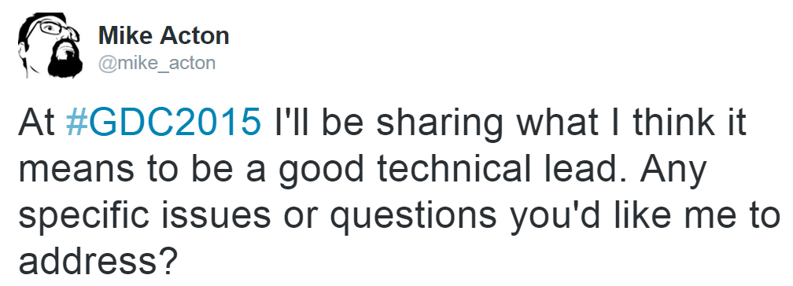

Slide 66
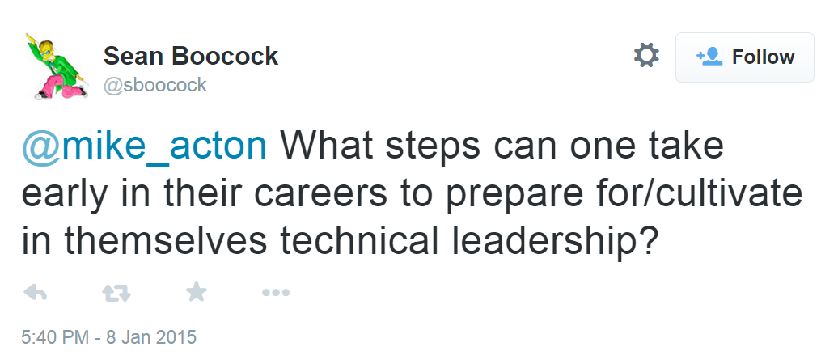

Slide 67
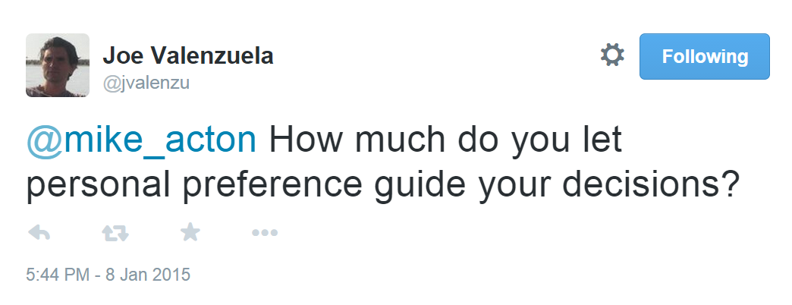

Slide 68
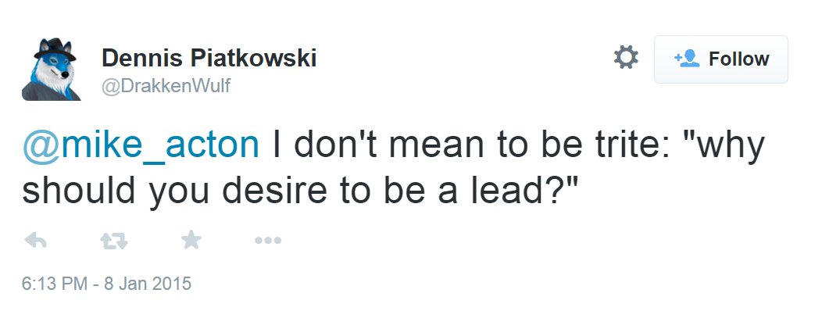

Slide 69
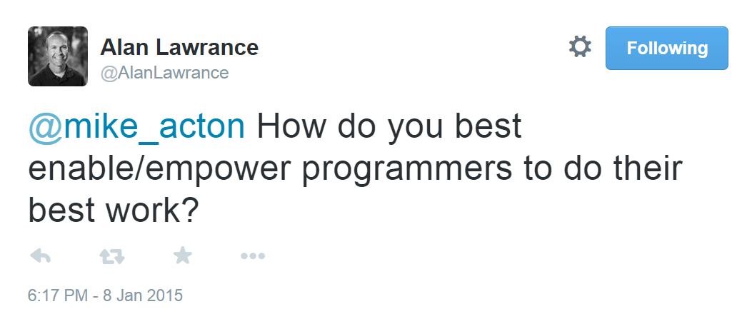

Slide 70
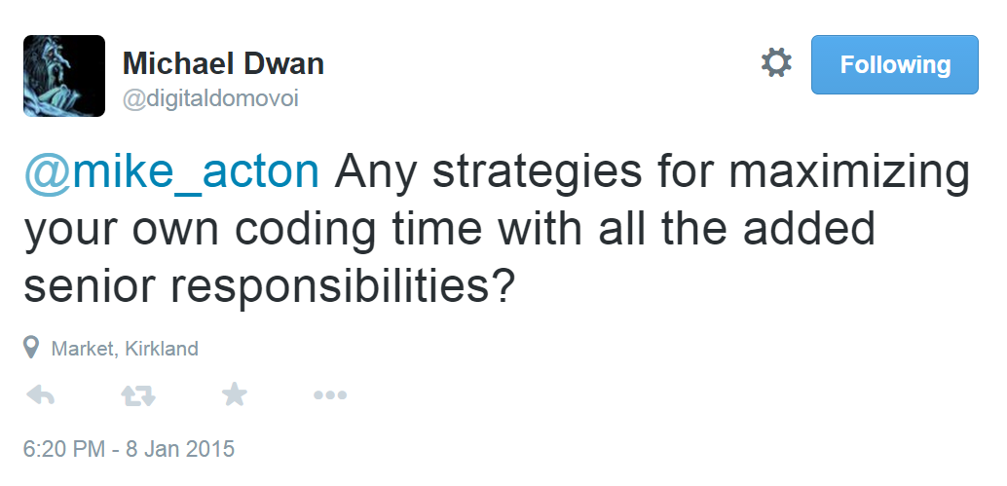

Slide 71
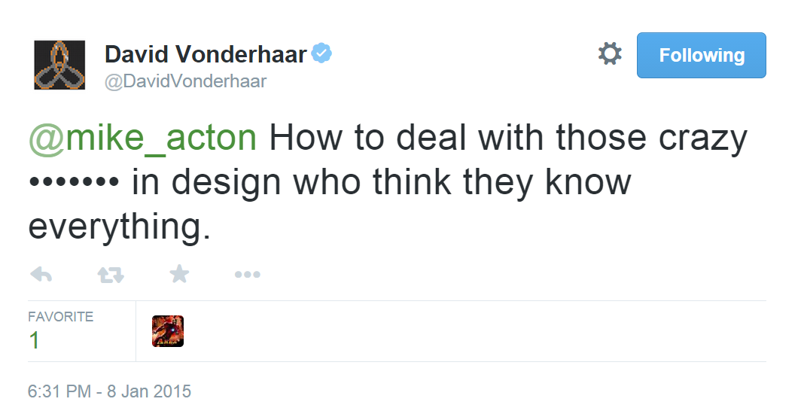

Slide 72
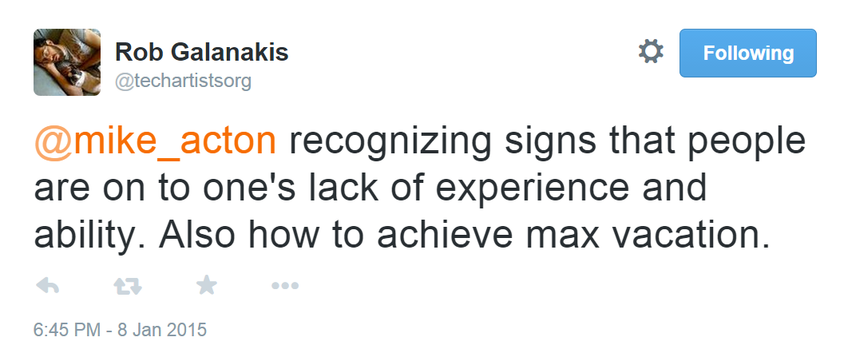

Slide 73
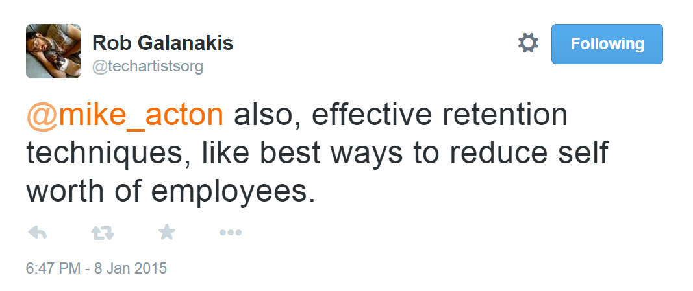

Slide 74
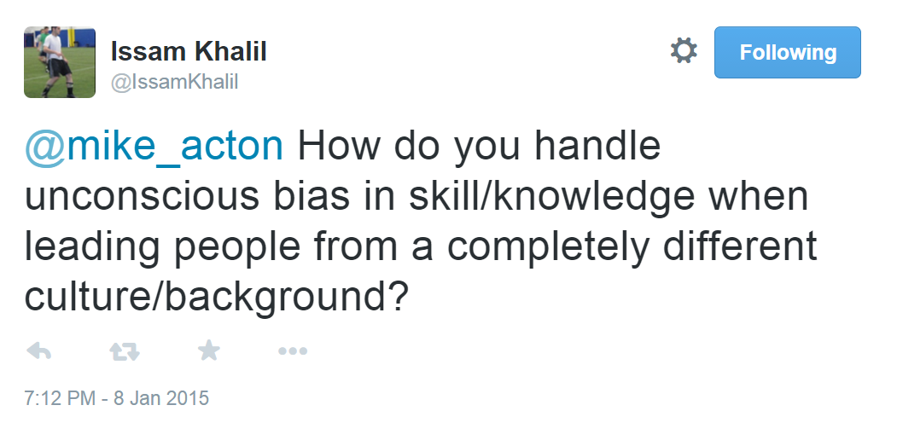

Slide 75
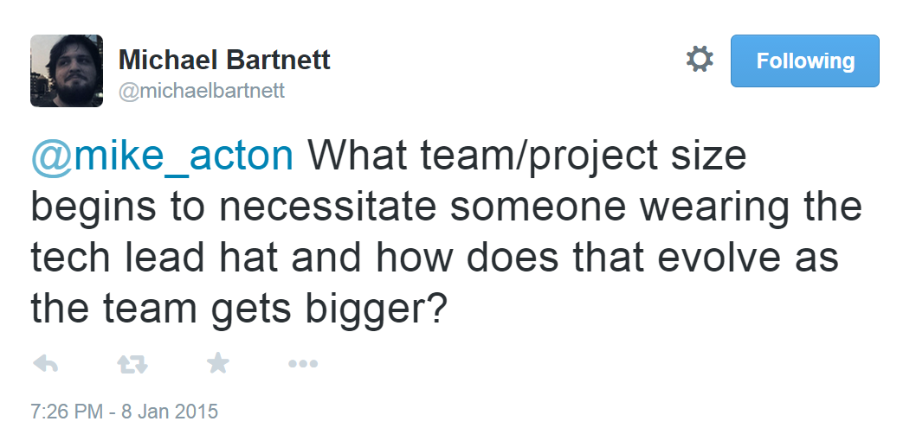

Slide 76
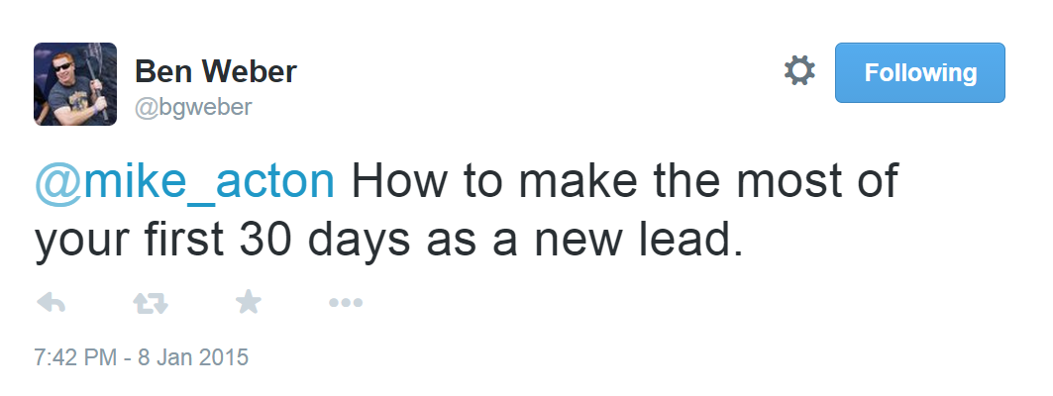

Slide 77
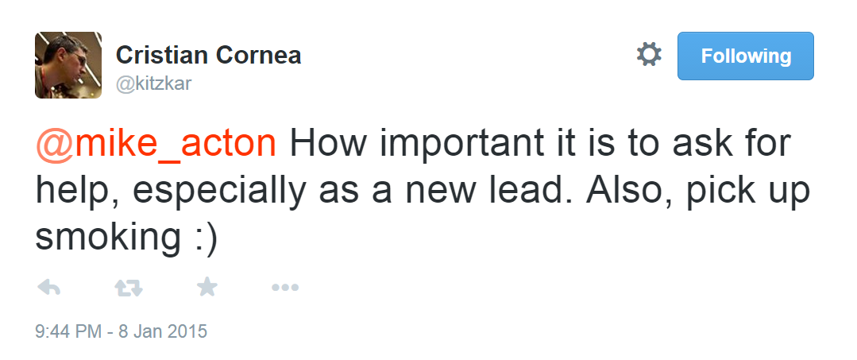

Slide 78
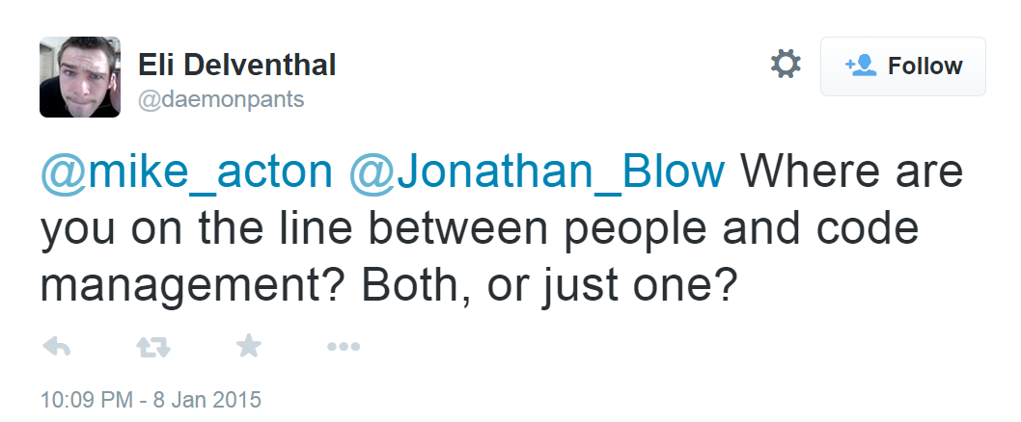

Slide 79
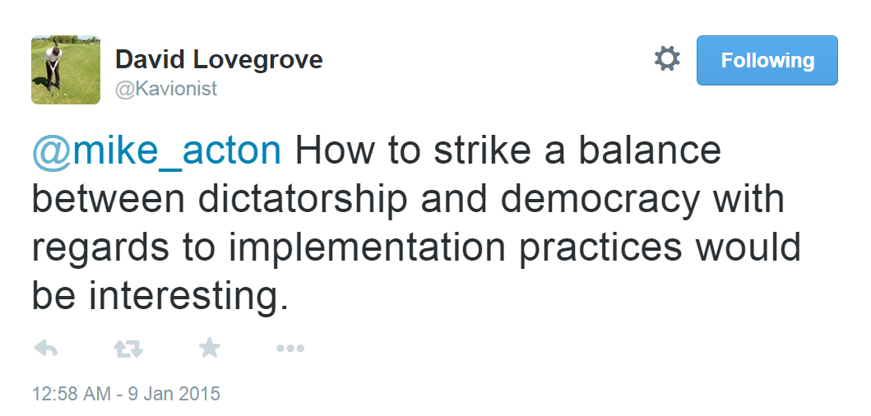

Slide 80
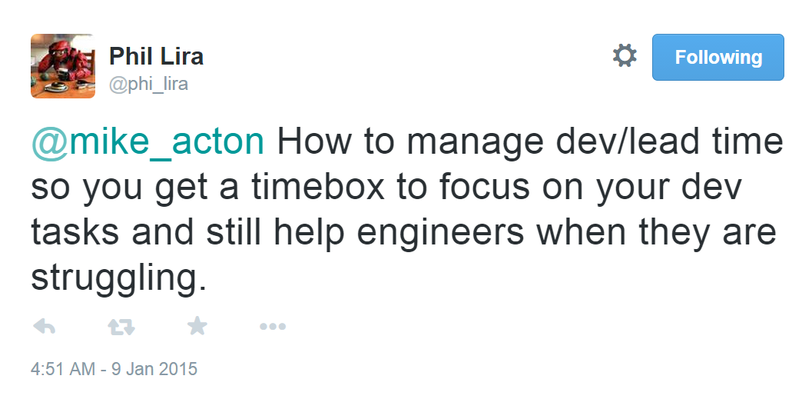

Slide 81
Other references
Madelaine Beermann http://linkd.in/1H0IvE3
(Leading High Performance Teams)
Keith Fuller http://www.fullergameproduction.com/
(Consultant Extraordanaire)

